Slide 1




October 16, 2024
Food Service Department

Slide 2
Educate
National School Lunch Program
Established under the Richard B. Russell National School Lunch Act, signed into law in 1946
Provides nutritionally balanced, low-cost or no-cost lunches to children each school day in public and nonprofit private schools and residential child care institutions (RCCIs)
Federally funded program
Federal meal pattern requirements
  Calories, fat, and sodium
  Whole grains, proteins, fruits, vegetables, milk
Reimbursement based on number of meals served

Slide 3
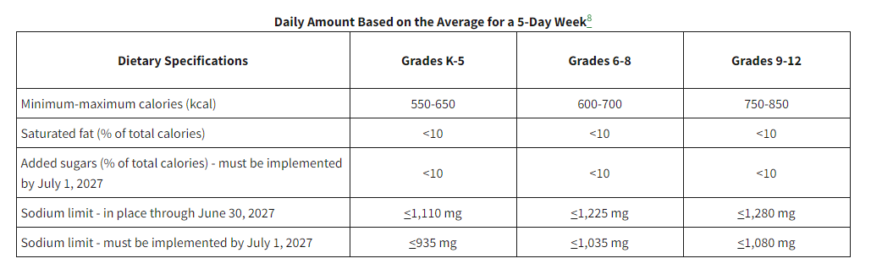
Educate

Slide 4
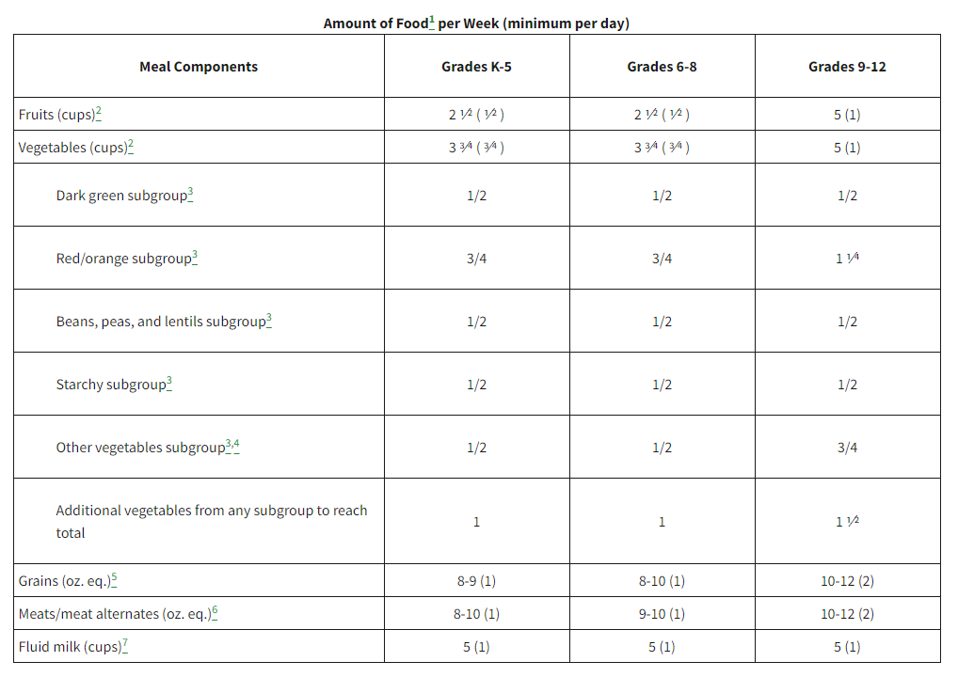
Educate

Slide 5
Educate
Smart Snacks
Any food and beverage sold to students during the school day
Must meet nutritional requirements for:
  Calories
  Sodium
  Fat
  Sugar

Slide 6
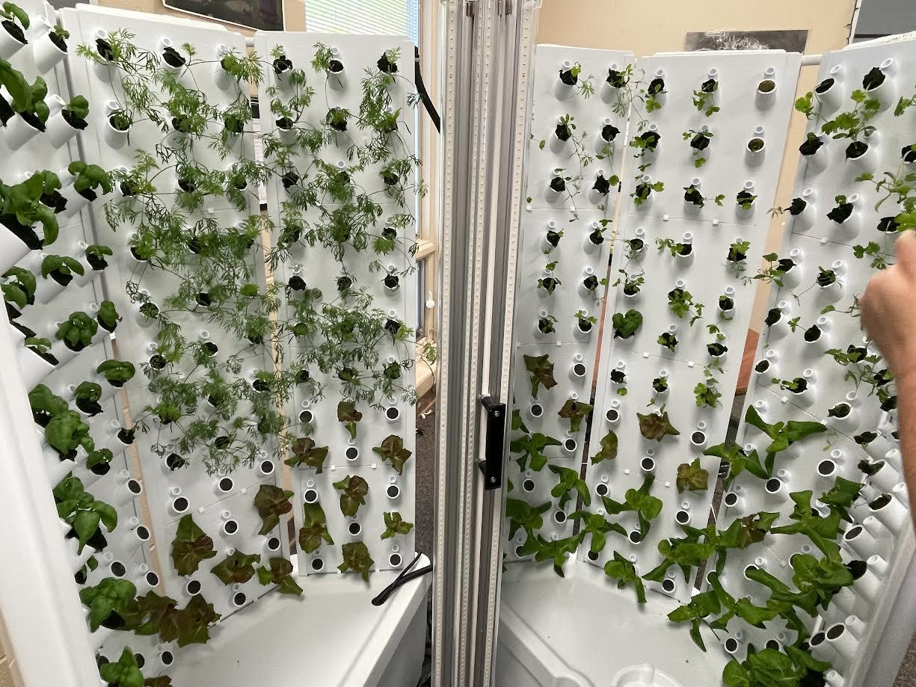
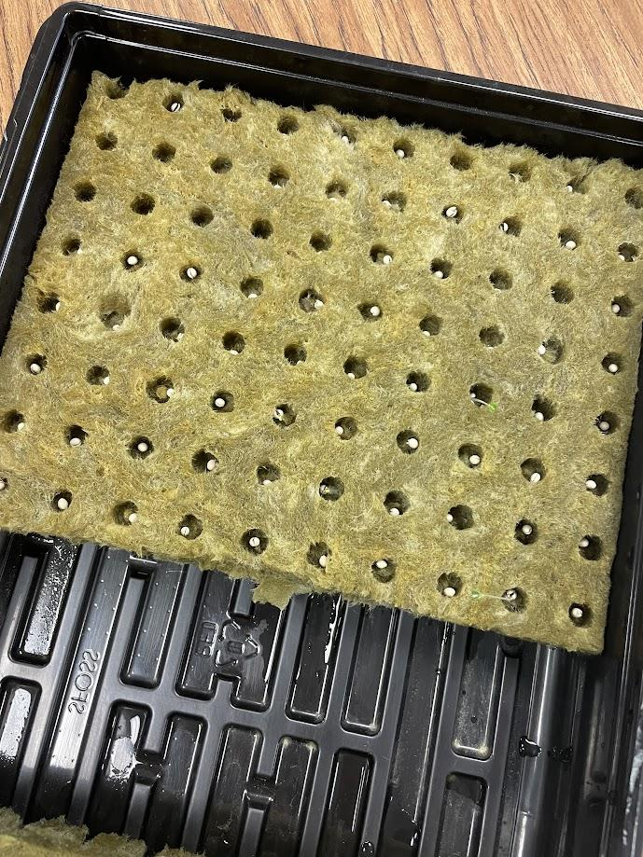
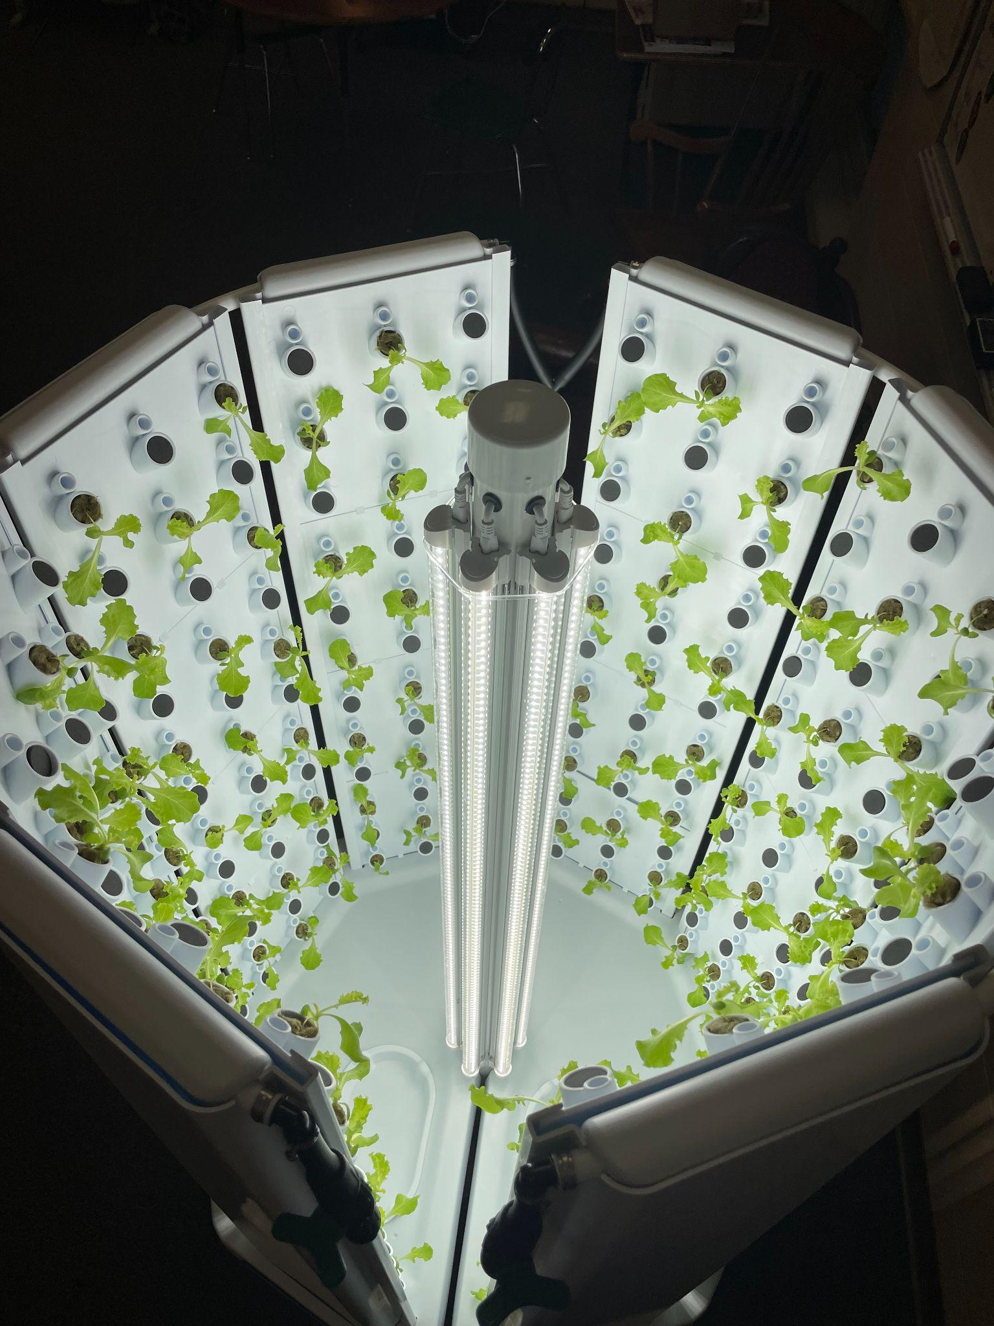
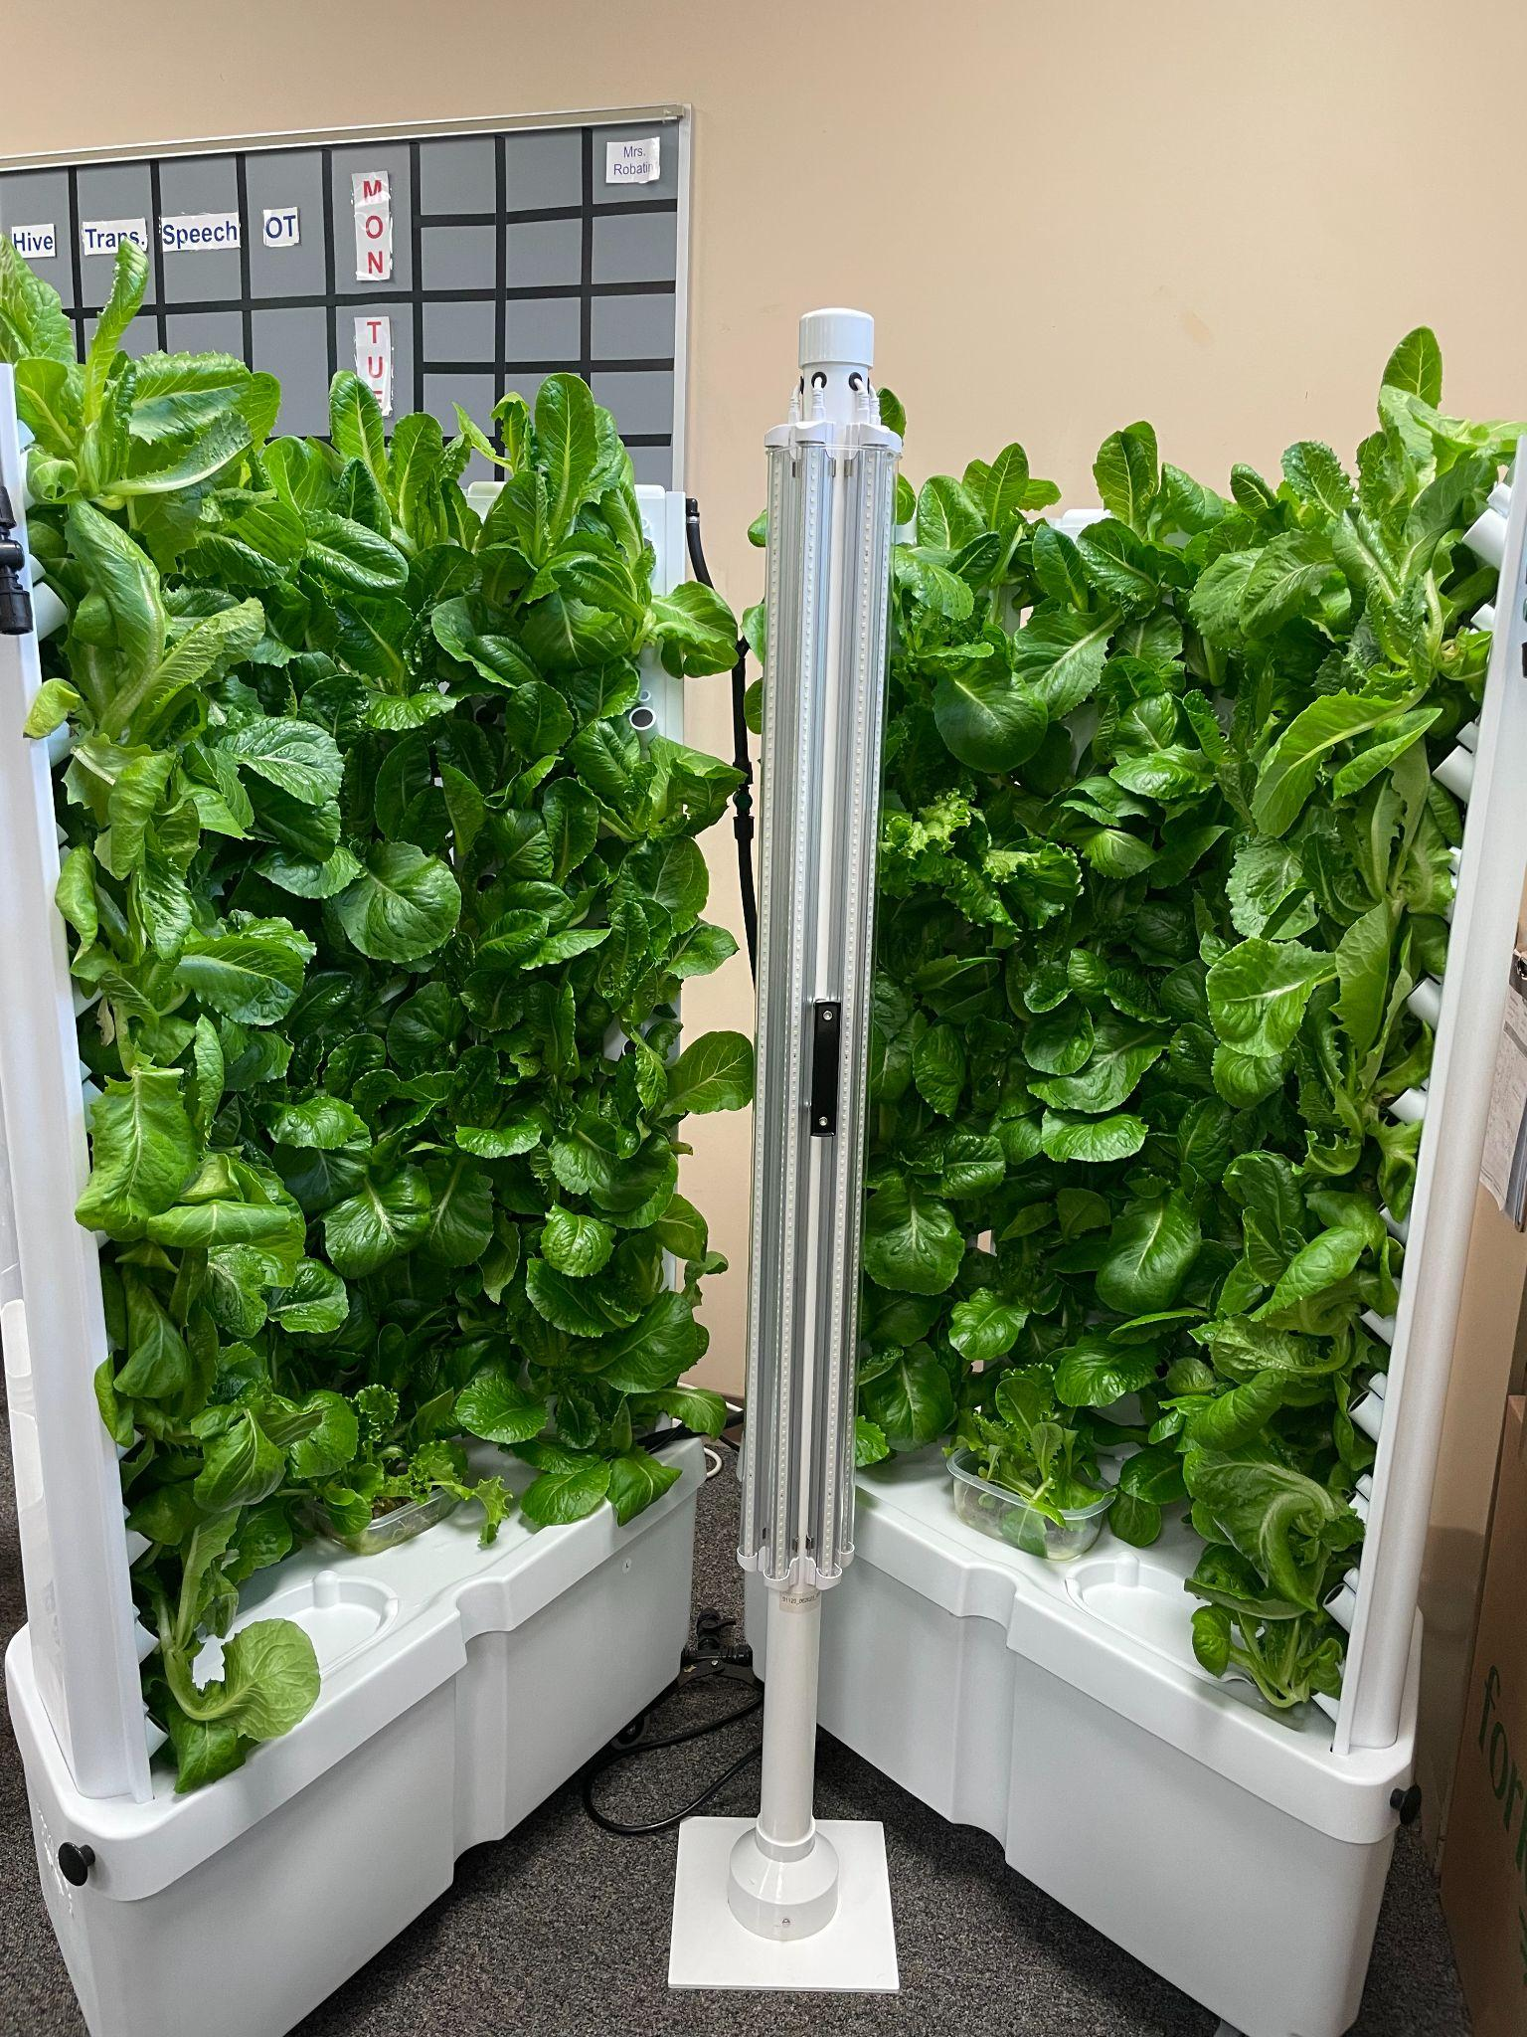
Empower
Hydroponic gardens at High School- Jeff Sidaway & Andi Wheelis
Lettuce, herbs
5-6 week process
  Plant seedlings in pod
  Transfer to tower
  Harvest every ~28 days
  Yields ~25 pounds of lettuce
  Lasts ~3 weeks in cooler

Slide 7
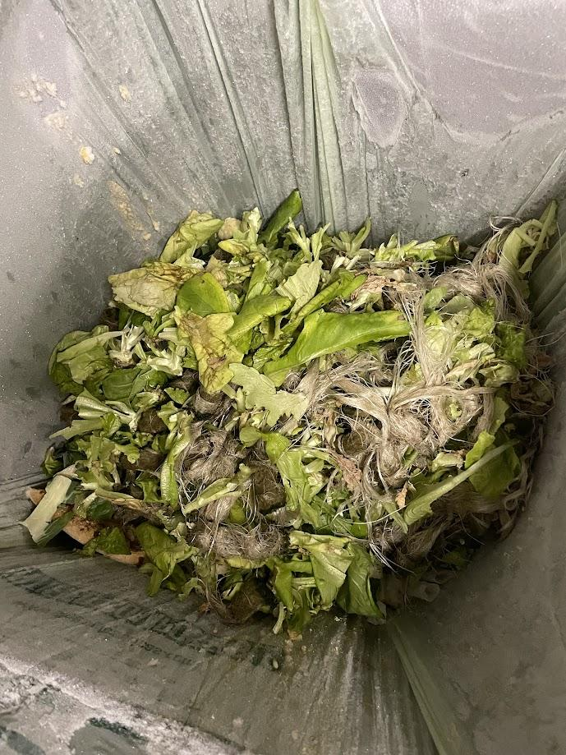
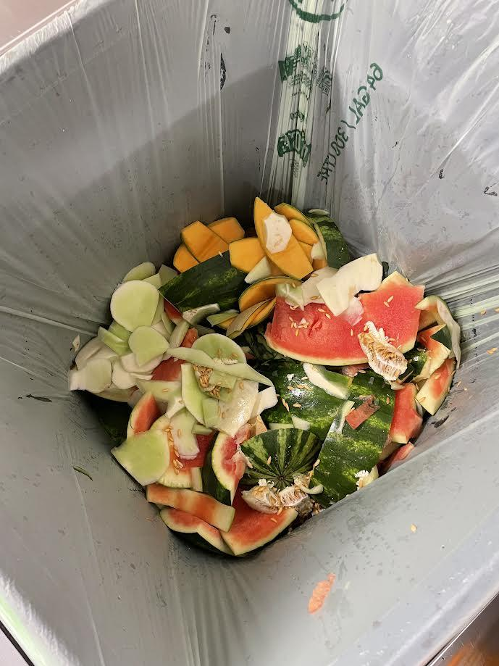
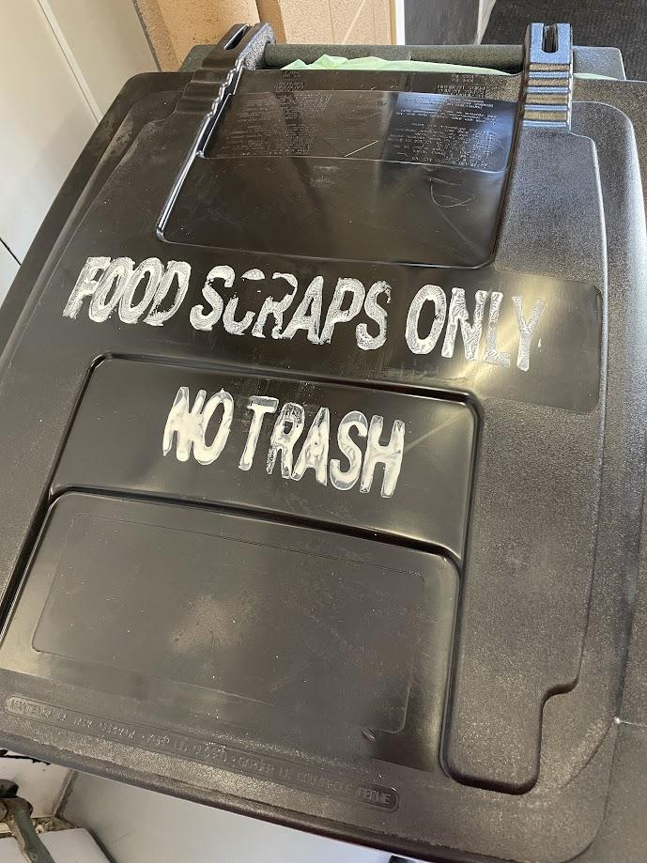
Empower
Composting Update
Rust Belt Riders has collected 1,187 pounds of food scraps from our kitchens
14 households signed up

Slide 8
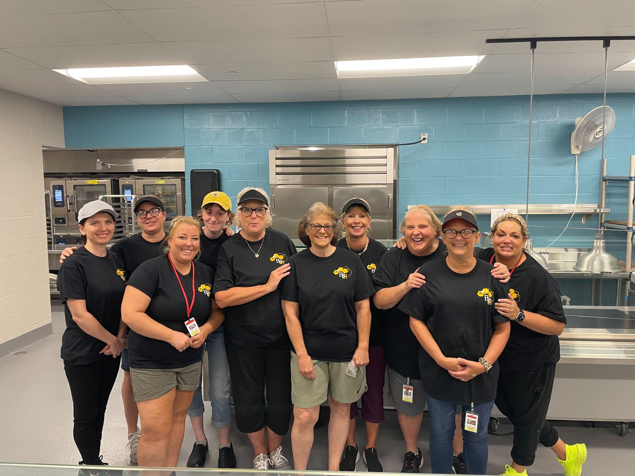
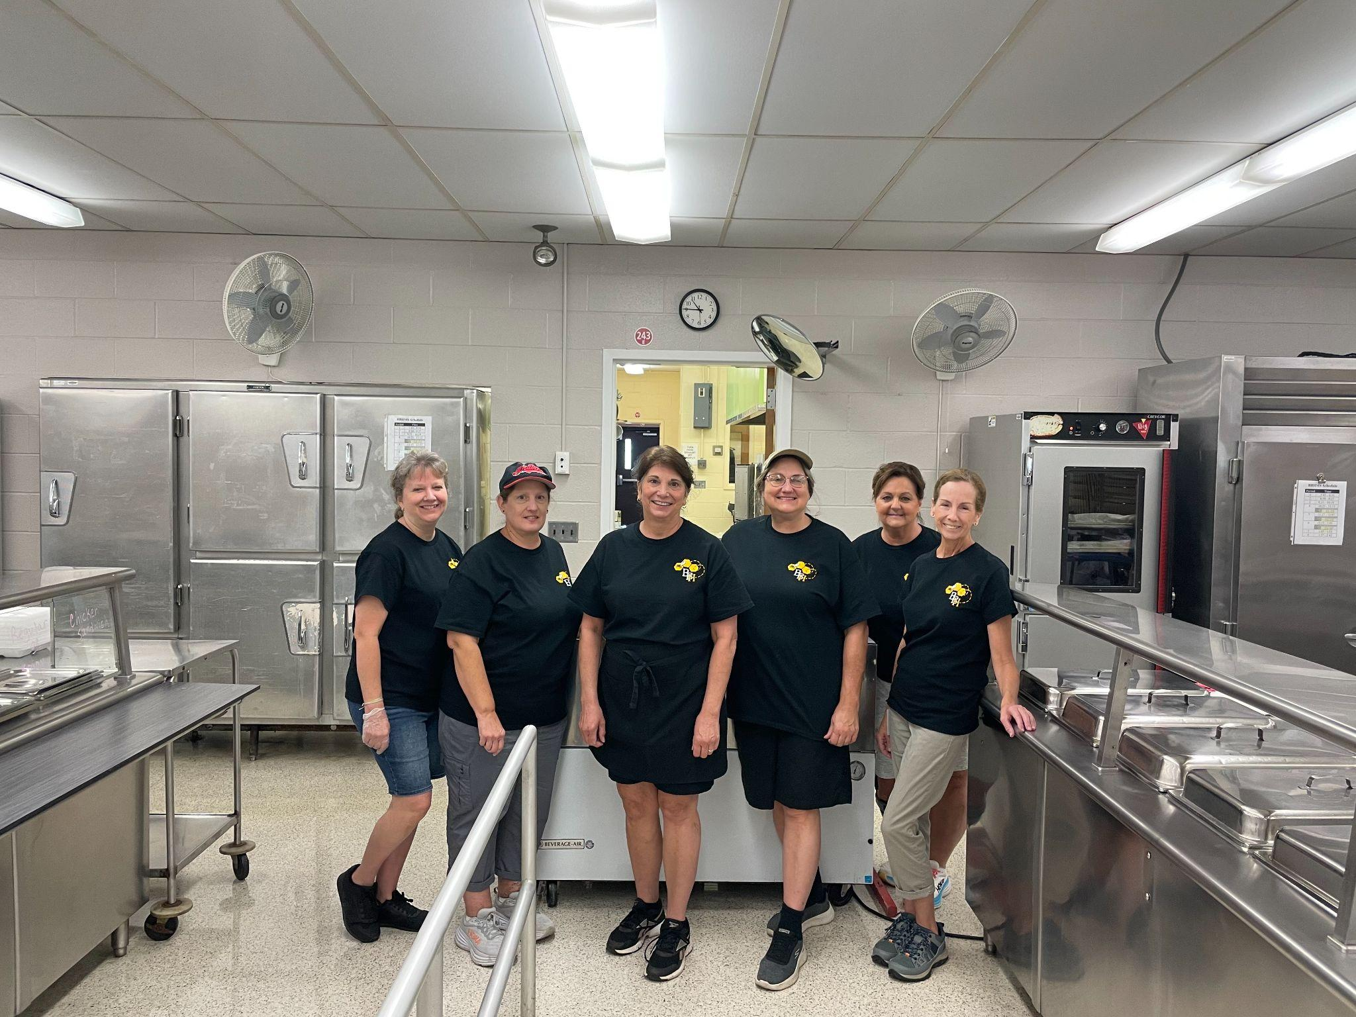

Engage
Elementary School
Middle School
High School

